Slide 1

© 2002, Cisco Systems, Inc. All rights reserved.

Slide 2

Starting a Router

Slide 3
Objectives
Upon completing this lesson, you will be able to:
  Start a router and recognize the normal boot sequence
  Use the command-line interface to interact with the Cisco IOS software, given an operational router
  Use the online help facilities associated with the command-line interfaces, given an operational router

Slide 4
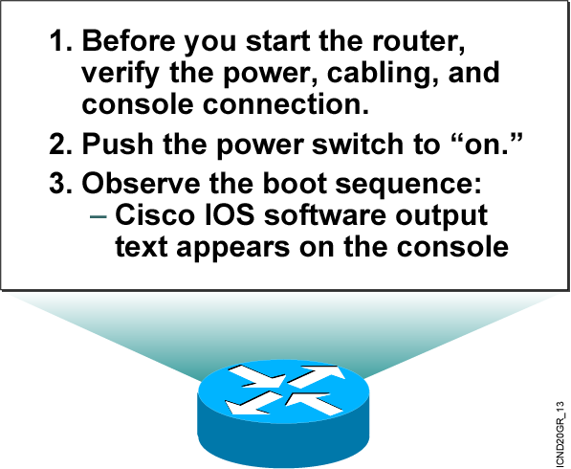
Initial Startup of the Cisco Router
  System startup routines initiate router software
  Router falls back to startup alternatives if needed
Notes:
Purpose: This slide describes a high-level overview of the startup sequences on the router.
Emphasize: A detailed flowchart covers this in much more detail in Chapter 6, “Catalyst Switch Operations.” Config register is also covered in Chapter 6.
The startup routines for Cisco IOS software have the goal of starting router operations. The router must deliver reliable performance connecting the user networks it was configured to serve. To do this, the startup routines must:
Make sure that the router comes up with tested hardware.
Find and load the Cisco IOS software that the router uses for its operating system.
Find and apply the configuration statements about router-specific attributes, protocol functions, and interface addresses.
The router will make sure that it comes up with tested hardware. When a Cisco router powers up, it performs a POST. These diagnostics verify the basic operation of the CPU, memory, and interface circuitry. After verifying the hardware functions, the router proceeds with software initialization. Some startup routines act as fallback operations that are able to perform the router startup should other routines be unable to do so. This flexibility allows Cisco IOS software to start up in a variety of initial situations.

Slide 5
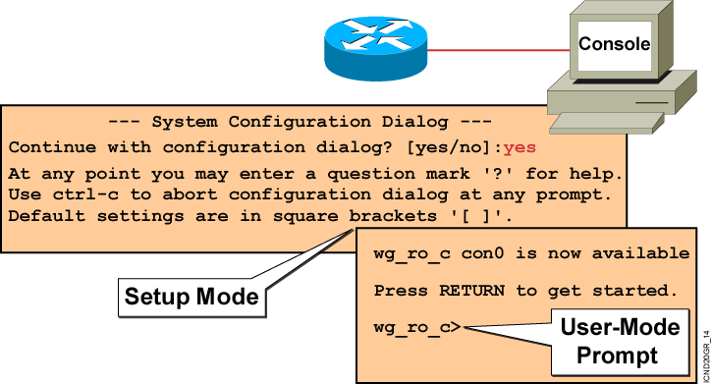
Bootup Output from the Router
  Unconfigured Versus Configured Router
Notes:
Purpose: This slide describes the difference between the console output of an unconfigured router and a configured router.
Emphasize: The router has setup mode to prompt the user for an initial configuration. The Catalyst 1900 switch has no setup mode, it comes with a factory default configuration.
Transition: The next series of slides shows the setup mode prompting.
Note: The setup mode prompting on Cisco IOS Release 12.0 is different than pre-release 12.0.

Slide 6
Setup: The Initial
Configuration Dialog
Router#setup
--- System Configuration Dialog ---
Continue with configuration dialog? [yes/no]: yes
At any point you may enter a question mark '?' for help.
Use ctrl-c to abort configuration dialog at any prompt.
Default settings are in square brackets '[]'.
Basic management setup configures only enough connectivity
for management of the system, extended setup will ask you
to configure each interface on the system
Would you like to enter basic management setup? [yes/no]: no
Notes:
Purpose: This slide describes the setup mode on the router.
Emphasize: One routine for initial configuration is the setup mode. The primary purpose of the setup mode is to rapidly bring up a minimal-feature configuration for any router that cannot find its configuration from some other source.
For many of the prompts in the system configuration dialog of the setup command facility, default answers appear in square brackets ([ ]) following the question. Pressing the Return key allows you to use the defaults. If the system was previously configured, the defaults that appear are the currently configured values. If you are configuring the system for the first time, the factory defaults are provided. If there is no factory default, as in the case of passwords, nothing is displayed after the question mark (?).
At this point, you can choose not to continue with the system configuration dialog and exit by entering No at the prompt. To begin the initial configuration process, enter Yes. You can press Ctrl-C to terminate the process and start over at any time. When you are using the command form of setup (Router#setup), Ctrl-C returns you to the privileged EXEC prompt (Router#).
If a “-- More --” prompt appears, press the space bar to continue.
Note: When the student performs the router setup mode lab later, make sure they select “no” at the “Would you like to enter basic management setup?” prompt.

Slide 7
Setup Interface Summary
First, would you like to see the current interface summary? [yes]:
Interface IP-Address OK? Method Status Protocol
BRI0 unassigned YES unset administratively down down
BRI0:1 unassigned YES unset administratively down down
BRI0:2 unassigned YES unset administratively down down
Ethernet0 unassigned YES unset administratively down down
Serial0 unassigned YES unset administratively down down
  Interfaces Found During Startup
Notes:
Purpose: This slide describes the setup mode on the router.

Slide 8
Setup Initial
Global Parameters
Configuring global parameters:
Enter host name [Router]:wg_ro_c
The enable secret is a password used to protect access to
privileged EXEC and configuration modes. This password, after
entered, becomes encrypted in the configuration.
Enter enable secret: cisco
The enable password is used when you do not specify an
enable secret password, with some older software versions, and
some boot images.
Enter enable password: sanfran
The virtual terminal password is used to protect
access to the router over a network interface.
Enter virtual terminal password: sanjose
Configure SNMP Network Management? [no]:
Notes:
Slide 1 of 2
Purpose: This slide describes the setup mode on the router.
Emphasize: You are prompted for global parameters at the console. You use the configuration values you have determined for your router to enter the global parameters at the prompts.
The first global parameter allows you to set the router host name. This host name will precede the Cisco IOS prompts for all configuration modes. At the factory the router name default is shown between the square brackets as [Router].
Use the next global parameters shown to set the various passwords used on the router.
You must enter an enable secret password. When you enter a string of password characters for the prompt to “Enter enable secret,” the characters are processed by Cisco-proprietary encryption, which can enhance the security of the password string. Whenever anyone lists the contents of the router configuration file, this enable password appears as a meaningless string of characters. Setup recommends, but does not require, that the enable password be different from the enable secret password.

Slide 9
Setup Initial
Protocol Configurations
Configure LAT? [yes]: no
Configure AppleTalk? [no]:
Configure DECnet? [no]:
Configure IP? [yes]:
Configure IGRP routing? [yes]: no
Configure RIP routing? [no]:
Configure CLNS? [no]:
Configure IPX? [no]:
Configure Vines? [no]:
Configure XNS? [no]:
Configure Apollo? [no]:
Notes:
Slide 2 of 2
Purpose: This slide describes the setup mode on the router.
Emphasize: When the students perform the lab later, make sure the students select “yes” to “Configure IP?” and “no” to all other protocols.

Slide 10
Setup Interface
Parameters
BRI interface needs isdn switch-type to be configured
Valid switch types are :
[0] none..........Only if you don't want to configure BRI.
[1] basic-1tr6....1TR6 switch type for Germany
[2] basic-5ess....AT&T 5ESS switch type for the US/Canada
[3] basic-dms100..Northern DMS-100 switch type for US/Canada
[4] basic-net3....NET3 switch type for UK and Europe
[5] basic-ni......National ISDN switch type
[6] basic-ts013...TS013 switch type for Australia
[7] ntt...........NTT switch type for Japan
[8] vn3...........VN3 and VN4 switch types for France
Choose ISDN BRI Switch Type [2]:
Configuring interface parameters:
Do you want to configure BRI0 (BRI d-channel) interface? [no]:
Do you want to configure Ethernet0 interface? [no]: yes
Configure IP on this interface? [no]: yes
IP address for this interface: 10.1.1.33
Subnet mask for this interface [255.0.0.0] : 255.255.255.0
Class A network is 10.0.0.0, 24 subnet bits; mask is /24
Do you want to configure Serial0 interface? [no]:
Notes:
Purpose: This slide describes the setup mode on the router.
Emphasize: You are prompted for parameters for each installed interface. You use the configuration values you have determined for your interface to enter the interface parameters at the prompts. Later on in the lab, the students will only be configuring an IP address on E0 only.
Note: With 12.0, the subnet mask is actually entered in dotted decimal format.

Slide 11
Setup Script
Review and Use
The following configuration command script was created:
hostname Router
enable secret 5 $1$/CCk$4r7zDwDNeqkxFO.kJxC3G0
enable password sanfran
line vty 0 4
password sanjose
no snmp-server
!
no appletalk routing
no decnet routing
ip routing
no clns routing
no ipx routing
no vines routing
no xns routing
no apollo routing
isdn switch-type basic-5ess
interface BRI0
shutdown
no ip address
!
interface Ethernet0
no shutdown
ip address 10.1.1.31 255.255.255.0
no mop enabled
!
interface Serial0
shutdown
no ip address
<text omitted>
end
[0] Go to the IOS command prompt without saving this config.
[1] Return back to the setup without saving this config.
[2] Save this configuration to nvram and exit.
Enter your selection [2]:
Notes:
Purpose: This slide describes the options available when exiting out of the setup mode on the router.
Emphasize: When you complete the configuration process, select [2] to save the configurations to NVRAM and make the configuration active in RAM.
If you select [0], the configuration is not saved to NVRAM or RAM.
Note: With 12.0, these are new options to select when exiting setup mode.

Slide 12
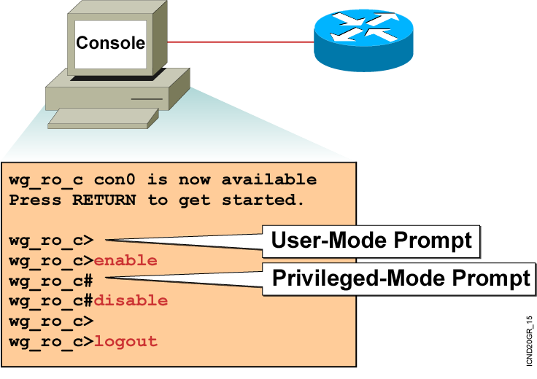
Logging In to the Router
Notes:
Purpose: This slide discusses the two EXEC modes.
Emphasize: Teach your students to look for and identify the prompt that indicates if they are in the correct mode for a given command.

Slide 13
Router User-Mode
Command List
wg_ro_c>?
Exec commands:
access-enable Create a temporary Access-List entry
atmsig Execute Atm Signalling Commands
cd Change current device
clear Reset functions
connect Open a terminal connection
dir List files on given device
disable Turn off privileged commands
disconnect Disconnect an existing network connection
enable Turn on privileged commands
exit Exit from the EXEC
help Description of the interactive help system
lat Open a lat connection
lock Lock the terminal
login Log in as a particular user
logout Exit from the EXEC
-- More --
  You can abbreviate a command to the fewest characters that make a unique character string.
Notes:
Emphasize: Notice that there are more commands available on the router than the Catalyst 1900 switch.

Slide 14
Router Privileged-Mode
Command List
wg_ro_c#?
Exec commands:
access-enable Create a temporary Access-List entry
access-profile Apply user-profile to interface
access-template Create a temporary Access-List entry
bfe For manual emergency modes setting
cd Change current directory
clear Reset functions
clock Manage the system clock
configure Enter configuration mode
connect Open a terminal connection
copy Copy from one file to another
debug Debugging functions (see also 'undebug')
delete Delete a file
dir List files on a filesystem
disable Turn off privileged commands
disconnect Disconnect an existing network connection
enable Turn on privileged commands
erase Erase a filesystem
exit Exit from the EXEC
help Description of the interactive help system
-- More --
  You can complete a command string by entering the unique character string, then pressing the Tab key.
Notes:
Emphasize: Notice that there are more commands available on the router than the Catalyst 1900 switch.

Slide 15
Router Command-Line Help Facilities
Context-Sensitive Help
Console Error Messages
Provides a list of commands and the arguments associated
with a specific command
Identifies problems with router commands that are incorrectly entered so you can alter or correct them
Command History Buffer
Allows recall of long or complex commands or entries for reentry, review, or correction
Notes:
Note: The Catalyst 1900 has a fixed history size of 10 which can’t be changed.

Slide 16
Router Context-Sensitive Help
Router#
clok
Translating "CLOK"
% Unknown command or computer name, or unable to find computer address
Router#
cl?
clear clock
Symbolic Translation
Command Prompting
Last Command Recall
Router#
clock
% Incomplete command.
Router#
clock ?
set Set the time and date
Router#
clock set
% Incomplete command.
Router#
<Ctrl-P>clock set ?
hh:mm:ss Current Time
Notes:
Slide 1 of 2
Emphasize: Suppose you want to set the router clock. If you do not know the command, use context-sensitive help to check the syntax for setting the clock. The help output shows that the set keyword is required. Next, check the syntax for entering the time.
Now enter the current time using hours, minutes, and seconds, as shown.
The system indicates that you need to provide additional arguments to complete the command. Press Ctrl-P (or Up arrow) to repeat the previous command entry automatically. Then add a space and a question mark (?) to reveal the additional arguments.
Now you can complete the command entry.
The caret symbol (^) and help response indicate an error. To list the correct syntax, reenter the command up to the point where the error occurred, and then enter a question mark (?).
Enter the year using the correct syntax and press Return to execute the command.
Note that the user interface provides syntax checking in the form of an error location indicator (^). The caret symbol character appears at the point in the command string where you entered an incorrect command, keyword, or argument. The error location indicator and interactive help system allow you to find and correct syntax errors easily.

Slide 17
Router Context-Sensitive Help (cont.)
Router# clok
Translating "CLOK"
% Unknown command or computer name, or unable to find computer address
Router#
clock set 19:56:00
% Incomplete command.
Router#
clear clock
Router#
clock set 19:56:00 ?
Command
Prompting
Syntax Checking
Command
Prompting
<1-31> Day of the month
Router#
MONTH Month of the year
% Incomplete command.
Router#
clock set 19:56:00 04 8
Router#
^
set Set the time and date
% Invalid input detected at the '^' marker
Router#
Router#
clock set 19:56:00 04 August
% Incomplete command.
% Incomplete command.
Router#
Router#
clock set 19:56:00 04 August ?
<1993-2035> Year
hh:mm:ss Current Time
Notes:
Slide 2 of 2

Slide 18
Enhanced Editing Commands
Router>Shape the future of internetworking by creating unpreced
  Shape the future of internetworking by creating unprecedented value for customers, employees, and partners.
Notes:
Layer 1 of 9
Purpose: This slide explains how to use the editing capabilities of Cisco IOS software.
Emphasize: Layer 1—Some commands can be longer than the number of characters available on the screen after the prompt. The user interface now supports automatic scrolling of long lines. Notice that we have run out of room on this line. The line will scroll over ten spaces at a time in order to allow longer lines.

Slide 19
Enhanced Editing Commands (cont.)
Router>$ value for customers, employees, and partners.
(Automatic scrolling of long lines.)
Ctrl-A
Move to the beginning of the command line.
Ctrl-E
Move to the end of the command line.
Esc-B
Move back one word.
Esc-F
Move forward one word.
Ctrl-B
Move back one character.
Ctrl-F
Move forward one character.
Ctrl-D
Delete a single character.
Notes:
Layer 9 of 9
Emphasize: Layer 9 — Ctrl-D deletes a single character.

Slide 20
Router Command History
Ctrl-P or Up Arrow
Recalls last (previous) commands
Ctrl-N or Down Arrow
Recalls more recent commands
show history
Shows command buffer contents
history size line
Sets the buffer size permanently
terminal history size lines
Sets session command buffer size
Notes:
Emphasize: The user interface provides a history or record of commands you have entered. This feature is particularly useful for recalling long or complex commands or entries. With the command history feature, you can complete the following tasks:
Set the command history buffer size
Recall commands
Disable the command history feature
By default, command history is enabled and the system records ten command lines in its history buffer. To change the number of command lines the system will record during the current terminal session, use the terminal history size or history size command. The maximum number of commands is 256.
To recall commands in the history buffer beginning with the most recent command, press Ctrl-P or the Up arrow key. Repeat the key sequence to recall successively older commands.To return to more recent commands in the history buffer after recalling commands with Ctrl-P or the Up arrow, press Ctrl-N or the Down arrow. Repeat the key sequence to recall successively more recent commands.
Once you enter the unique characters for a command, press the Tab key and the interface will finish the entry for you.
On most laptop computers you may also have additional select and copy facilities available. Copy a previous command string, then paste or insert it as your current string.
Note: The Catalyst 1900 has a fixed history size of ten which can’t be changed.

Slide 21
show version Command
wg_ro_a#show version
Cisco Internetwork Operating System Software
IOS (tm) 2500 Software (C2500-JS-L), Version 12.0(3), RELEASE SOFTWARE (fc1)
Copyright (c) 1986-1999 by cisco Systems, Inc.
Compiled Mon 08-Feb-99 18:18 by phanguye
Image text-base: 0x03050C84, data-base: 0x00001000
ROM: System Bootstrap, Version 11.0(10c), SOFTWARE
BOOTFLASH: 3000 Bootstrap Software (IGS-BOOT-R), Version 11.0(10c), RELEASE SOFTWARE(fc1)
wg_ro_a uptime is 20 minutes
System restarted by reload
System image file is "flash:c2500-js-l_120-3.bin"
(output omitted)
--More--
Configuration register is 0x2102
Notes:
Purpose: This slide presents the show version command.
Emphasize: Point out that this command is useful when troubleshooting problems because it gives the versions of the various software components and files. It also displays how long the router has been in operation and where it obtained the image file.
Config register is discussed in Chapter 6, “Catalyst Switch Operations.”

Slide 22
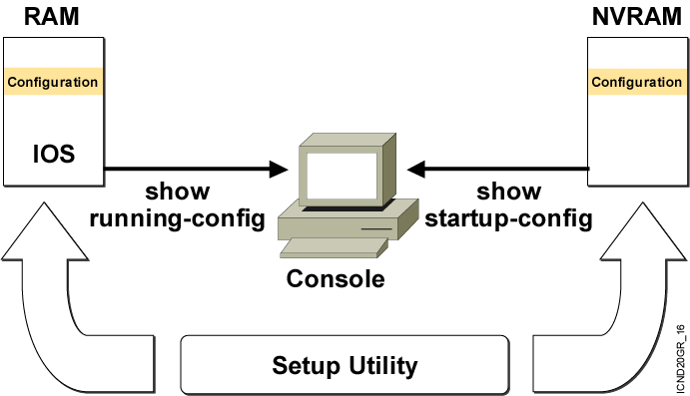
Viewing the Configuration
Notes:
Emphasize: When you exit the setup mode, the configuration can be saved to RAM and NVRAM at the same time.
Note: The Catalyst 1900 has no show start command. It automatically saves the running configuration to NVRAM.

Slide 23
show running-config and show startup-config Commands
In RAM
In NVRAM
wg_ro_c#show running-config
Building configuration...
Current configuration:
!
version 12.0
!
-- More --
wg_ro_c#show startup-config
Using 1359 out of 32762 bytes
!
version 12.0
!
-- More --
  Displays the current and saved configuration
Notes:
Purpose: This slide shows the format and output of the show running-config and show startup-config commands, which display the active and backup configuration files, respectively.
Emphasize: We put these two commands on the same page because it is easy to confuse the two. The show running-config command displays the configuration information in memory, while the show startup-config command displays the backup file.
Often in class someone will enter commands and then say that the router did not accept them. This scenario might indicate that the person entered the commands to modify the configuration information in memory, and then entered a show startup-config (show config) to look at the backup file that has not yet been updated to reflect the changes. You must use another command to update the backup file.
Default parameters do not display in the running configuration.
In Cisco IOS Release 10.2 and earlier, the write terminal command shows the running configuration, and the show config command shows the startup configuration.

Slide 24
Summary
  The startup of a Cisco router requires that you verify the physical installation, power up the router, and view the Cisco IOS software output on the console.
  The router startup sequence is similar to the startup sequence of the Catalyst switch. The router first performs POST, then it finds and loads the IOS image. Finally, it finds and loads the device configuration file.
  Use the enable command to access the privileged EXEC mode from the user EXEC mode.

Slide 25
Summary (Cont.)
  The Cisco router uses Cisco IOS software with extensive command-line input help facilities, including context-sensitive help.
  The Cisco IOS CLI includes an enhanced editing mode that provides a set of editing key functions.
  The Cisco router CLI provides a history or record of commands you have entered. This feature, called the command history, is particularly useful to help you recall long or complex commands or entries.
  After logging in to a Cisco router, you can verify the router initial startup status using the router status commands: show version, show running-configuration, and show startup-configuration.

Slide 26


